Slide 1
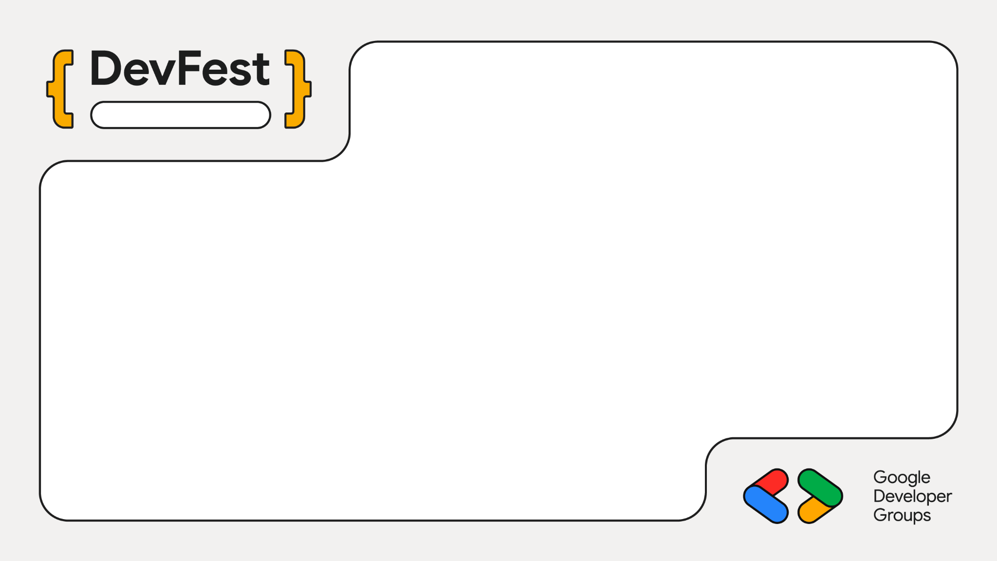
Durgapur
Turning Rough One-Liners into Actionable JIRA Tickets with Gemma
Mayur Madnani

Slide 2
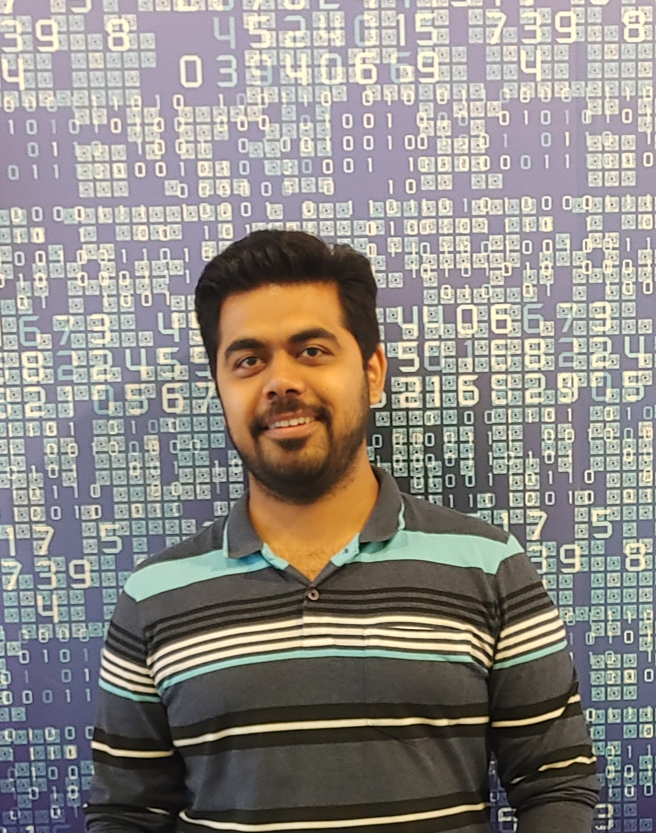
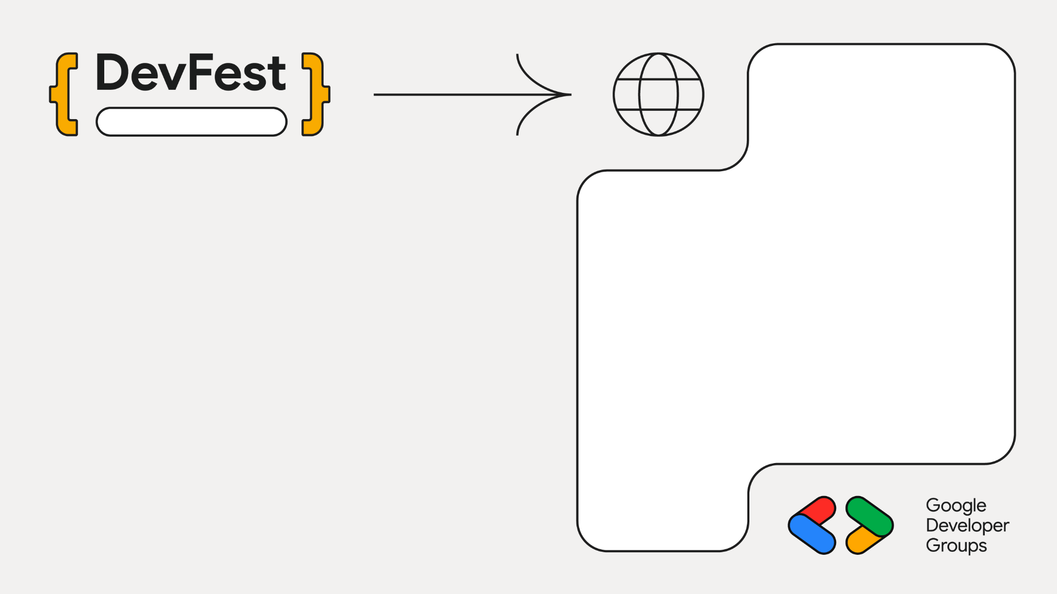
Durgapur
Staff Engg @ JioHotstar
Previously @ Intuit, Walmart, SAP
Expertise in Data, AI and Backend
~10 years in the Industry
GenAI Course Author
Mentor
Speaker
Mayur Madnani

Slide 3
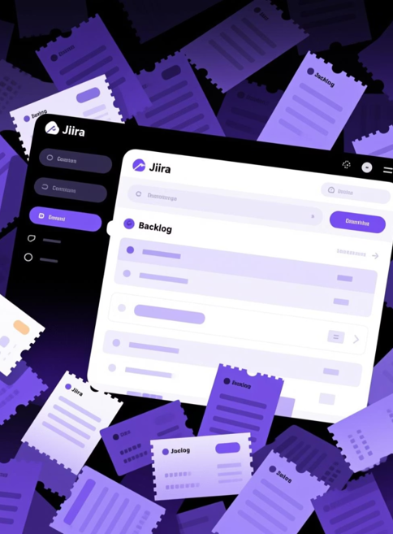

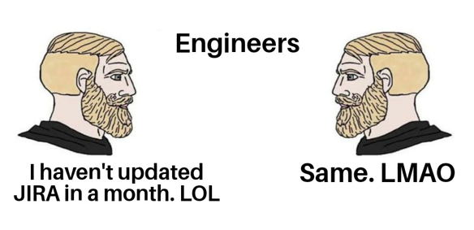
Backlog grooming = soul-draining manual work
Incomplete notes → confusion → poor sprint planning
Meme: “When PM says ‘just write better tickets’”
The Developer Reality Check

Slide 4
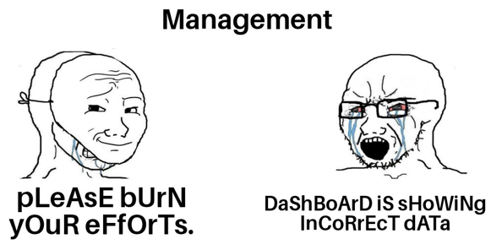
Product managers struggle to keep dev notes structured
Context loss between idea → JIRA ticket
Leads to rework, low velocity
The Management Problem

Slide 5
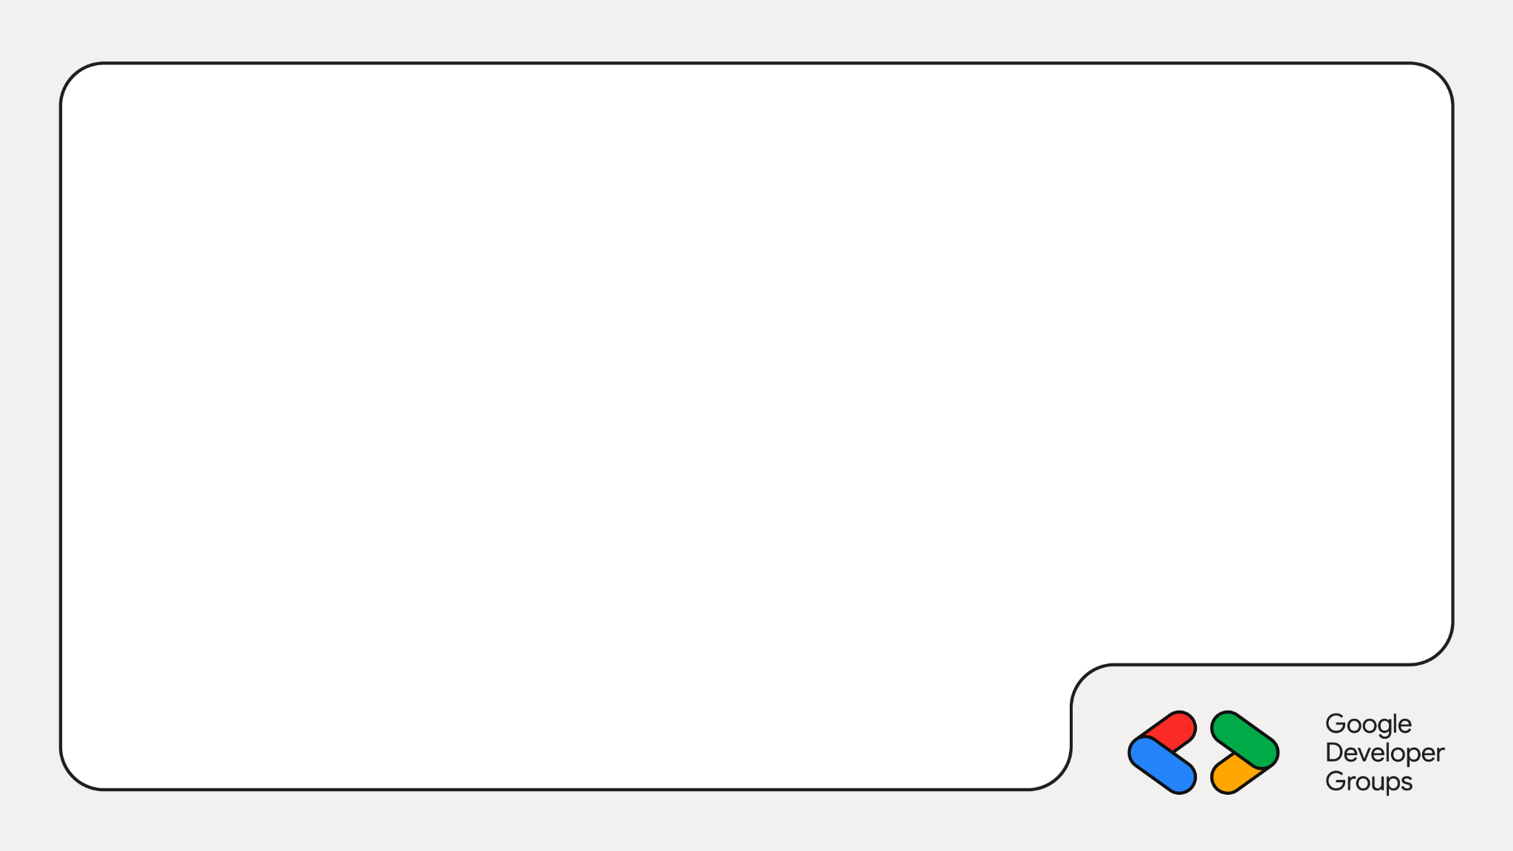
Enter: The TicketTuner Agent
Transform messy developer notes into production-ready tickets automatically.
Input
Raw, unstructured developer notes and quick thoughts
Model Processing
Gemma on Cloud Run intelligently parses and structures
Output
Complete ticket with title, description, acceptance criteria, priority

Slide 6
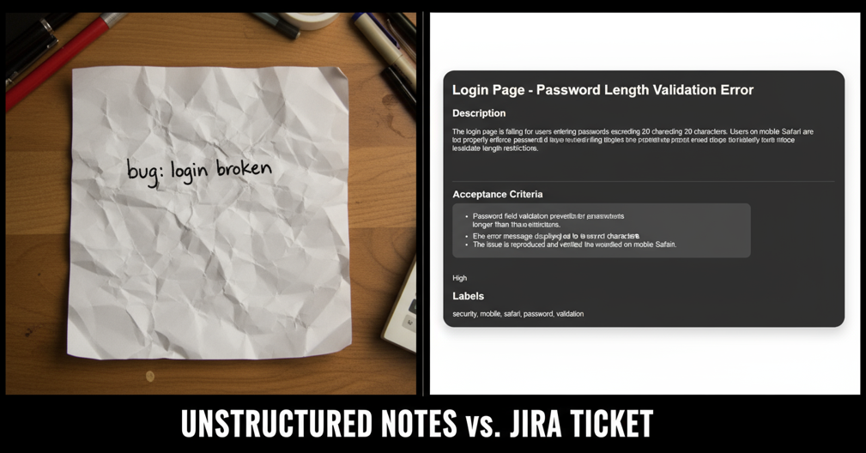

Slide 7
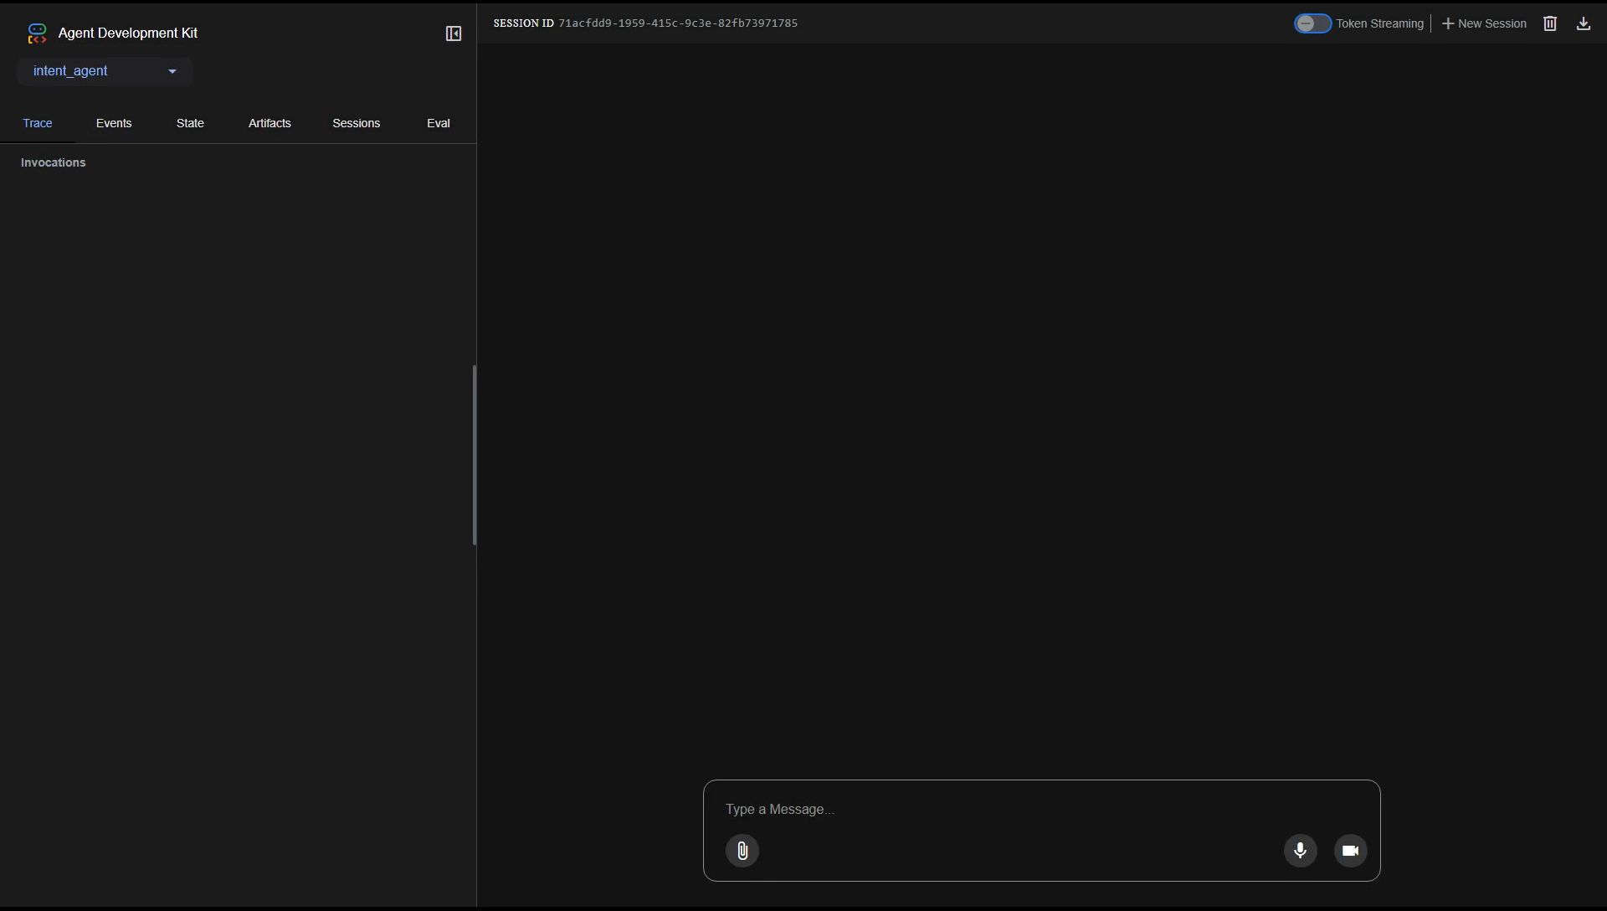
Demo

Slide 8
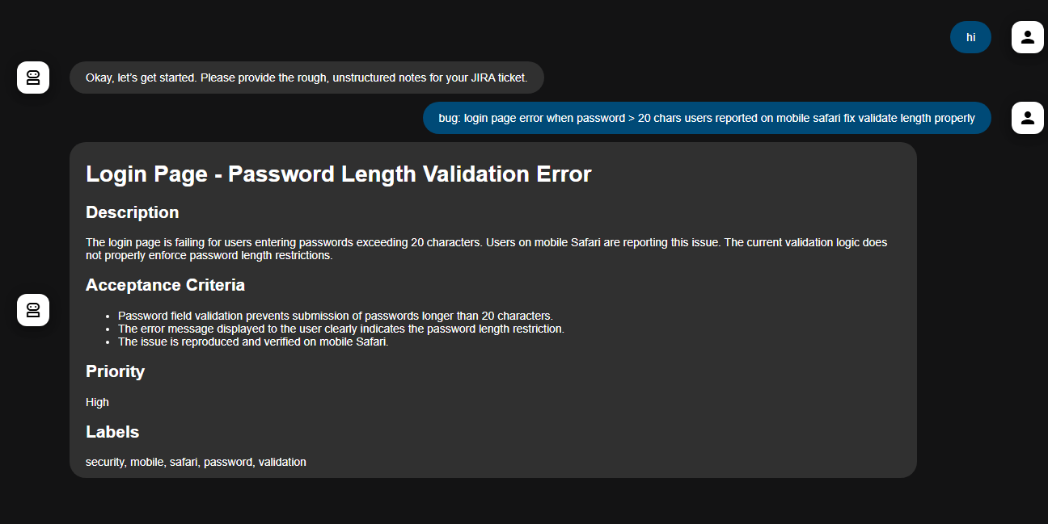
Demo

Slide 9
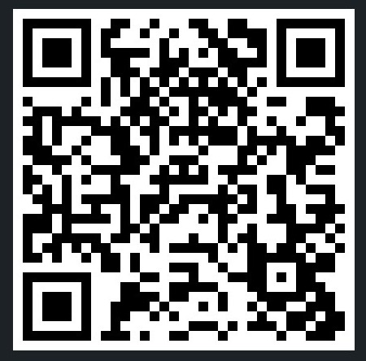
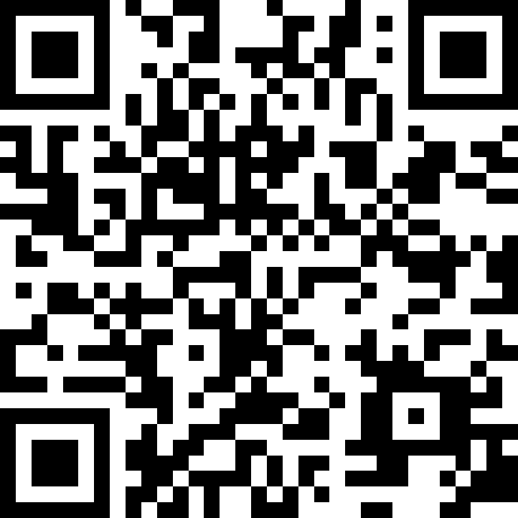
🌐linkedin.com/in/mayurmadnani
🌐github.com/mayurmadnani/workshop-gcp-intent-to-agents

